Slide 1

Battle of Neighborhoods
Gnyana Teja Samudrala

Slide 2
Introduction
The business activity within any local market tends to be unevenly distributed, some neighborhoods simply attract more activity than others. Economic development within a neighborhood also tends to have a direct impact on several measures of well-being among its residents.
So, for this reason a fitness expert who is trying to open an own Yoga studio in Toronto, Canada wants to do analysis of the neighborhood in deciding the place to establish the business.

Slide 3
Data description
The list of neighborhoods in Toronto are fetched from the Wikipedia page. Also, the latitude and longitude of these locations are added by using the geocoder package. By using the foursquare API, we can get a list of various venues that are present in each of the neighborhood.
We obtain top 100 venues of each neighborhood in 1000m radius.
Using this analyze most common top 10 places of each neighborhood.
Then cluster the neighborhoods.
From this clustering we can decide on a subset of neighborhoods for consideration.
Once we have the first subset of neighborhoods, then we fetch the details of venues which offer physical fitness such as gyms, yoga studios, spas, pools etc.
From this data we can analyze and cluster each neighborhood with what type of venues they have and give out a well data backed judgement of the locality to open a yoga studio.

Slide 4
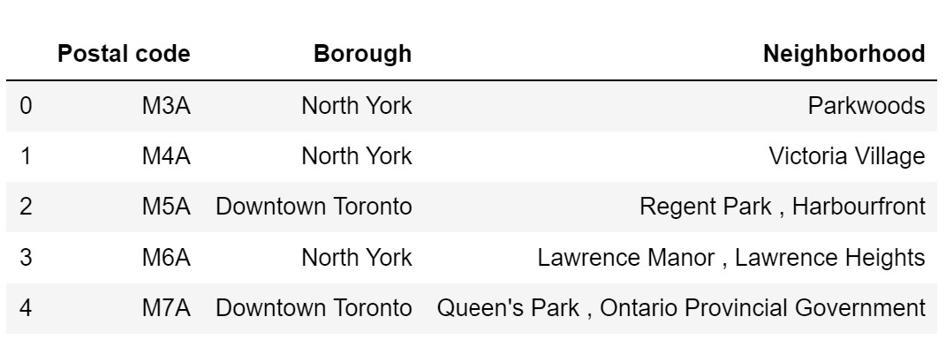
Methodology
Scraping neighborhood data
This is the first step, in which we obtain the neighborhood data of Toronto from the Wikipedia page. Once we have the data, the not assigned borough rows are removed from the data frame. This data frame has 103 entries, which means we have that many number of options to choose from.

Slide 5
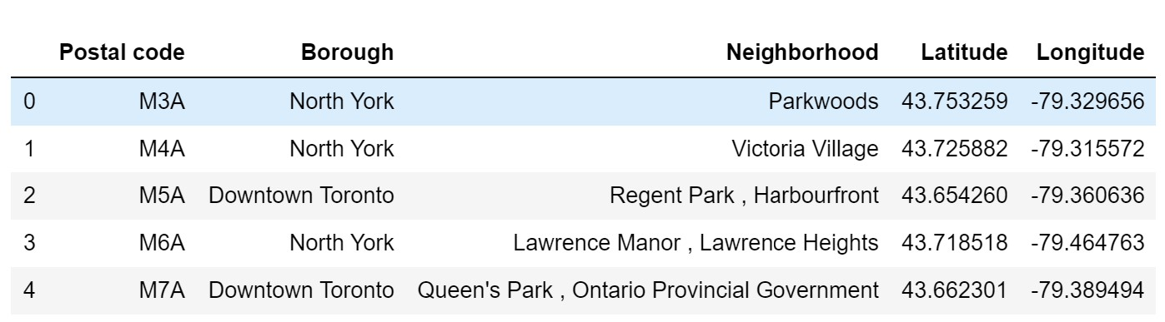
Methodology
Merging Latitude and Longitude
Now using the geocoder package, we get the latitude and longitude of each neighborhood and put it in the data frame.

Slide 6
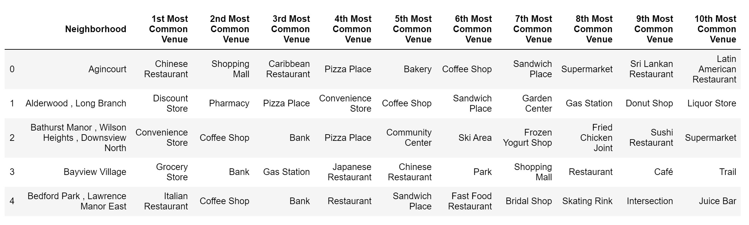
Methodology
Fetching the top 100 venues
Using the foursquare API, we collect top 100 venues around 1000m radius of each neighborhood. These venues belong to various categories, in this case we got a total number of 327 unique categories of venues.

Slide 7
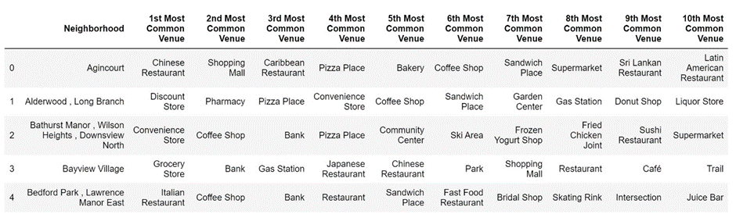
Methodology
From this we analyze the occurrence of each category type and sort them out as 10 most common places for each neighborhood, to get an idea of each type of neighborhood.

Slide 8
Methodology
Clustering
The K-Means clustering algorithm is used to cluster the neighborhoods, depending on the 10 most common venue categories. We cluster them into 5 groups. By looking at each of the cluster we can get an idea of what cluster to proceed to for establishing a yoga studio. Once a cluster is decided we can move ahead with further refining the cluster to decide upon a specific neighborhood. The results of the clustering are discussed in the results section.
Fetching venues of Outdoor and Recreation category
Once the cluster is decided from a above method, we fetch the venues belonging to the outdoor and recreation category from the foursquare API. Once we have the venues, we repeat the same process of analyzing by getting the 10 most common venues of each neighborhood and clustering. This time clustering is done into 3 groups.

Slide 9
Results
From the first clustering of top 100 venues of all categories, we get to know the neighborhoods based on the frequency of occurrence of each category in top 3 most common places. From the bar graph below in fig.6 corresponding to each cluster we can observe cluster 1 would be the idea spot to establish a yoga studio as gym is the third most common category in this cluster and it occurred more frequently than any other cluster. All the other cluster are ideal places where we can have food joints, shopping malls, and tourism spots, which are not a place we want to establish a yoga studio.

Slide 10
Results
So, in cluster 1 we have a total of 50 neighborhood options to decide. From each of the neighborhood we get the list of venues belonging to the outdoor and recreation category. We repeat a similar kind of most common venue categories among them and cluster them into 3 groups. We can remove cluster 2 & 3 from the option as we have occurrences of a yoga studio in all 3 most common venues and on the other hand cluster 1 frequency for yoga studio is low. So cluster 1 is where we need to look closely for a potential neighborhood.
The cluster 1 data has 13 neighborhoods to choose from, but by removing the neighborhoods with yoga studio among 3 most common venues we are down to eight venues to choose from.

Slide 11
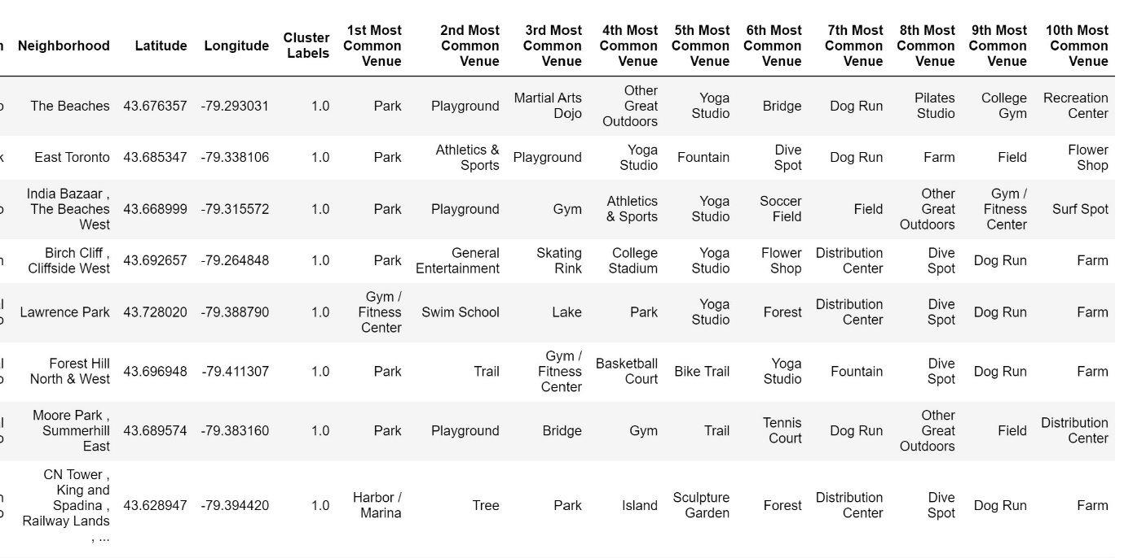
Conclusion
Among the 8 potential neighborhoods presented, the first 6 neighborhoods have yoga studio among 10 most common venues. But the last two does not have a yoga studio among 10 most common venues, so these two are a better candidate for establishing a new yoga studio. But among these two going for Moore Park, Summerhill East neighborhood is a good option as it has Gym, tennis court and other outdoor physical activities, and opening a yoga studio there might be a useful as people in that neighborhood give an importance to physical fitness. But on the other hand, CN Tower has other kinds of activities in 10 most common venues which are sculpture garden, farm and forest which does not show their interest to a yoga studio. Hence Moore Park, Summerhill East the red marker in the map shown in fig.9 is the best potential neighborhood for opening a yoga studio.

Slide 12
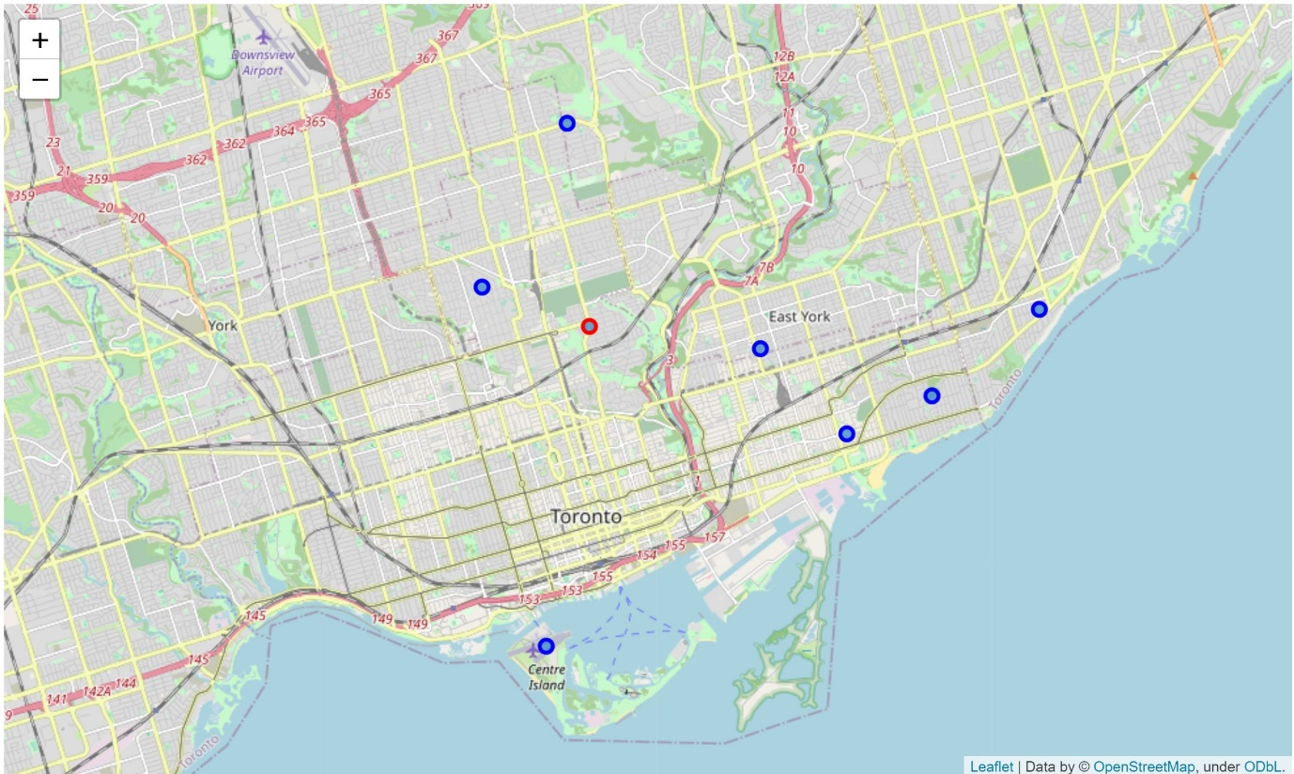
Conclusion

